Slide 1

Polymorphism

Slide 2
What is it?
Let’s take a look at these examples
Two subclasses of Vehicle
We have a Vehicle superclass
Last time we have learned how to re-implement an instance method from a superclass
Vehicle.java
Three methods with the same name but different message
class Vehicle { public void drive() { System.out.println(“Vehicles can be driven"); } }
Bus.java
Car.java
class Bus extends Vehicle { public void drive() { System.out.println(“Buses can be driven"); } }
public static void main(String args[]) {
Vehicle v = new Bus();
v.drive();
}
class Car extends Vehicle { public void drive() { System.out.println(“Cars can be driven"); } }
public static void main(String args[]) {
Vehicle v = new Car();
v.drive();
}

Slide 3
Because the object type is Vehicle but the initialization is a Car type
Vehicle.java
If we would replace the Car with the Vehicle then the result will change as well
class Vehicle { public void drive() { System.out.println(“Vehicles can be driven"); } }
In the syntax we will see that there is a Car instead of a Vehicle
What will the Car class display?
Car IS-A Vehicle
Car.java
class Car extends Vehicle { public void drive() { System.out.println(“Cars can be driven"); } }
public static void main(String args[]) {
Vehicle v = new Car();
v.drive();
}
class Car extends Vehicle { public void drive() { System.out.println(“Cars can be driven"); } }
public static void main(String args[]) {
Vehicle v = new Vehicle();
v.drive();
}
Why?
OUTPUT
Vehicles can be driven
Cars can be driven

Slide 4
What about Bus class?
Again!
Vehicle.java
class Vehicle { public void drive() { System.out.println(“Vehicles can be driven"); } }
Vehicle type
Bus initialization
Bus.java
class Bus extends Vehicle { public void drive() { System.out.println(“Buses can be driven"); } }
public static void main(String args[]) {
Vehicle v = new Bus();
v.drive();
}
The method that will run will be from Bus Class
OUTPUT
Vehicles can be driven

Slide 5
Now let’s take a look at all the classes
Vehicle.java
class Vehicle { public void drive() { System.out.println(“Vehicles can be driven"); } }
1 Superclass
Bus.java
class Bus extends Vehicle { public void drive() { System.out.println(“Buses can be driven"); } }
2 Subclasses
3 Same-Name Methods
Car.java
3 Different Messages
class Car extends Vehicle { public void drive() { System.out.println(“Cars can be driven"); } }

Slide 6
3 Outputs
Vehicle.java
class Vehicle { public void drive() { System.out.println(“Vehicles can be driven"); } }
OUTPUT
Vehicles can be driven
Buses can be driven
Cars can be driven
1 Main Class
Bus.java
class Bus extends Vehicle { public void drive() { System.out.println(“Buses can be driven"); } }
Demo.java
Class Demo {
public static void main(String args[]) {
Vehicle v = new Vehicle();
Vehicle b = new Bus();
Vehicle c = new Car();
v.drive(); // Vehicle Message
b.drive(); // Bus Message
c.drive(); // Car Message
}
}
Car.java
class Car extends Vehicle { public void drive() { System.out.println(“Cars can be driven"); } }

Slide 7
Now you are going to say
Ok, great you showed us overriding again, so?
Actually Polymorphism and Overriding are strongly related to each other
Poly = Many
Polymorphism
Doing a single action in many ways
Morph = Form

Slide 8
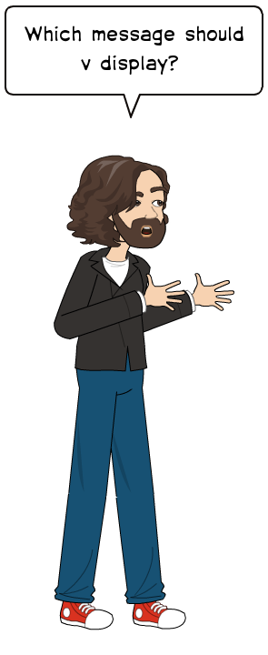

We had three different classes with three different messages and the ability to call a single method *drive()* to display one of the three mesages
Vehicle.java
class Vehicle { public void drive() { System.out.println(“Vehicles can be driven"); } }
1
Bus.java
class Bus extends Vehicle { public void drive() { System.out.println(“Buses can be driven"); } }
2
Car()
Vehicle v = new
Vehicle()
Bus()
v.drive();
Car.java
OUTPUT
class Car extends Vehicle { public void drive() { System.out.println(“Cars can be driven"); } }
Vehicles can be driven
3
Cars can be driven
Buses can be driven

Slide 9
After all the examples, we now know that polymorphism is the ability to use the same function once but have different results
But… Polymorphism can be classified into two types
Runtime
Polymorphism
All the examples presented so far
Compile Time
Next

Slide 10
For the Compile Time we will take another example
We have a class
Same.java
class Same { public void same(int a, int b) { System.out.println(“Two integers: “ + a + “, ” + b); }
public void same(double a) { System.out.println(“One double: “ + a); }
public void same(int a) { System.out.println(“ An integer: “ + a); } }
With three same-name methods inside it
In the runtime we had different classes with a same-name method inside each of them
In the compile time all of the methods with the same name are inside one class
This procedure is called
Method Overloading

Slide 11
Same.java
Ok Great
class Same { public void same(int a, int b) { System.out.println(“Two integers: “ + a + “, ” + b); }
public void same(double a) { System.out.println(“One double: “ + a); }
public void same(int a) { System.out.println(“ An integer: “ + a); } }
But…
How does the program know who is who?
Maybe you have noticed the fact that each method has different parameters

Slide 12
Same.java
Same.java
class SameTest { public static void main(String[] args) {
Same s = new Same();
s.same(10, 20);
s.same(4.5);
s.same(45);
} }
class Same { public void same(int a, int b) { System.out.println(“Two integers: “ + a + “, ” + b); }
public void same(double a) { System.out.println(“One double: “ + a); }
public void same(int a) { System.out.println(“ An integer: “ + a); } }
OUTPUT
Two integers: 10, 20
One double: 4.5
An integer: 45
Let’s give it a try!

Slide 13
Review
Polymorphism
Doing a single action in many ways
Poly = Many
Morph = Form

Slide 14
Polymorphism
Runtime
Compile Time
Vehicle.java
Same.java
class Vehicle { public void drive() { System.out.println(“Vehicles can be driven"); } }
class Same { public void same(int a, int b) { System.out.println(“Two integers: “ + a + “, ” + b); }
public void same(double a) { System.out.println(“One double: “ + a); }
public void same(int a) { System.out.println(“ An integer: “ + a); } }
Bus.java
class Bus extends Vehicle { public void drive() { System.out.println(“Buses can be driven"); } }

